Slide 1

The Reviver A web based application for finding doctors in critical situations
Proposed by:
Saurov Chandra Biswas
Roll: 16CSE018
Dept. of Computer Science & Engineering
Supervised by:
Md. Samsuddoha
Assistant Professor
Dept. of Computer Science & Engineering
University of Barishal

Slide 2

Contents
Overview
Problem statement
Objectives
Motivation
Existing Works
Findings
Features
Implementation Plan
Timeline
Challenges
Limitations
Future work
Q & A?

Slide 3
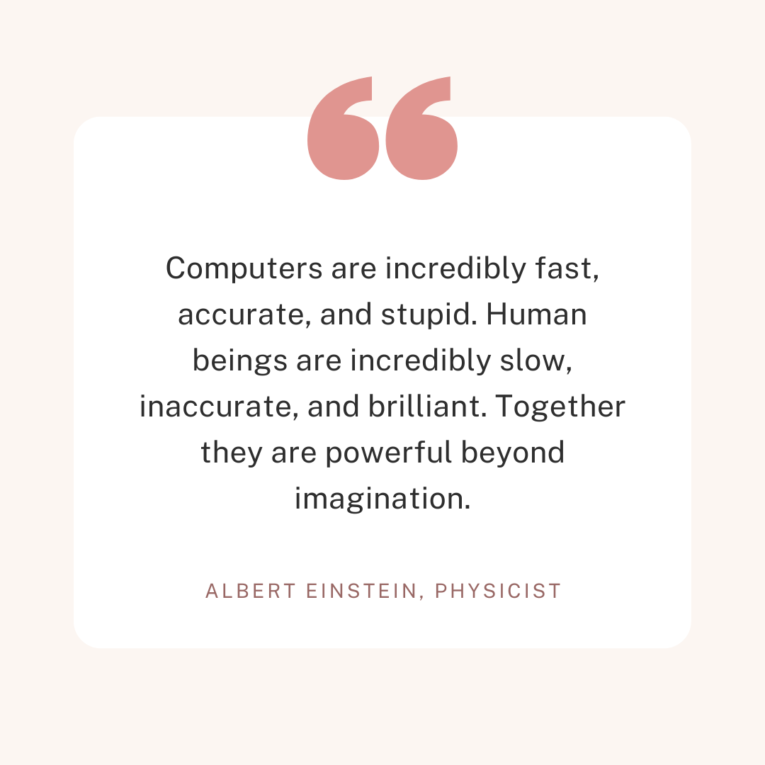
Overview
Web based application.
Finds available doctors in critical situation.
Emergency online consultancy.
Doctors and Patients can communicate.

Slide 4
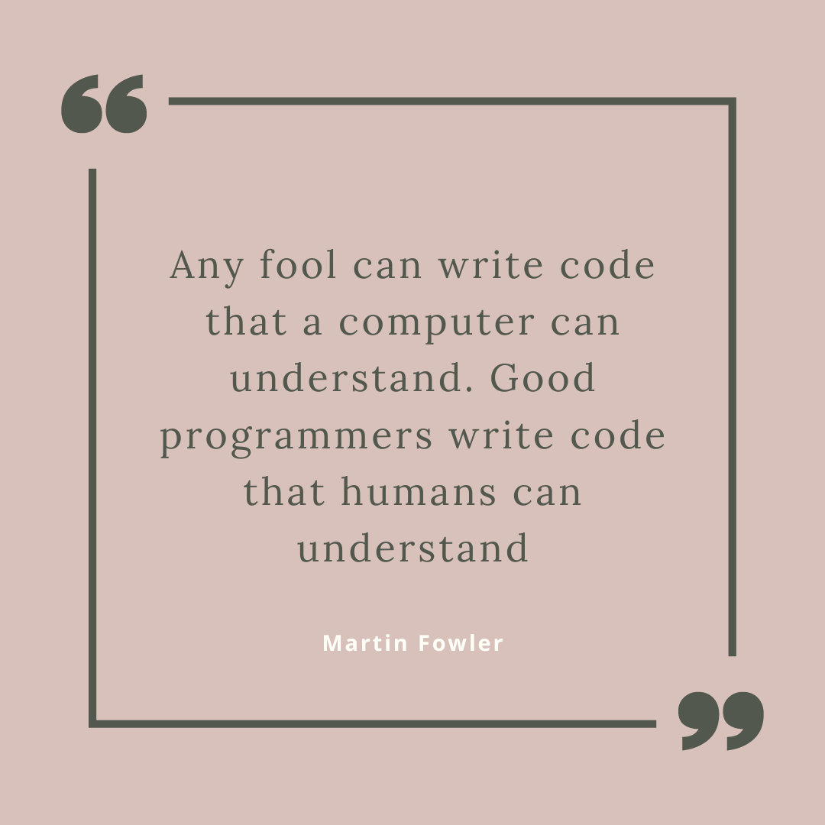
Problem Statement
Where to find a doctor if you fall on an emergency?
What to do if you need an emergency consultation with a doctor?
Our medical & private consultation system is broken and messy. We all know it.
What if you need medical care at late night?

Slide 5
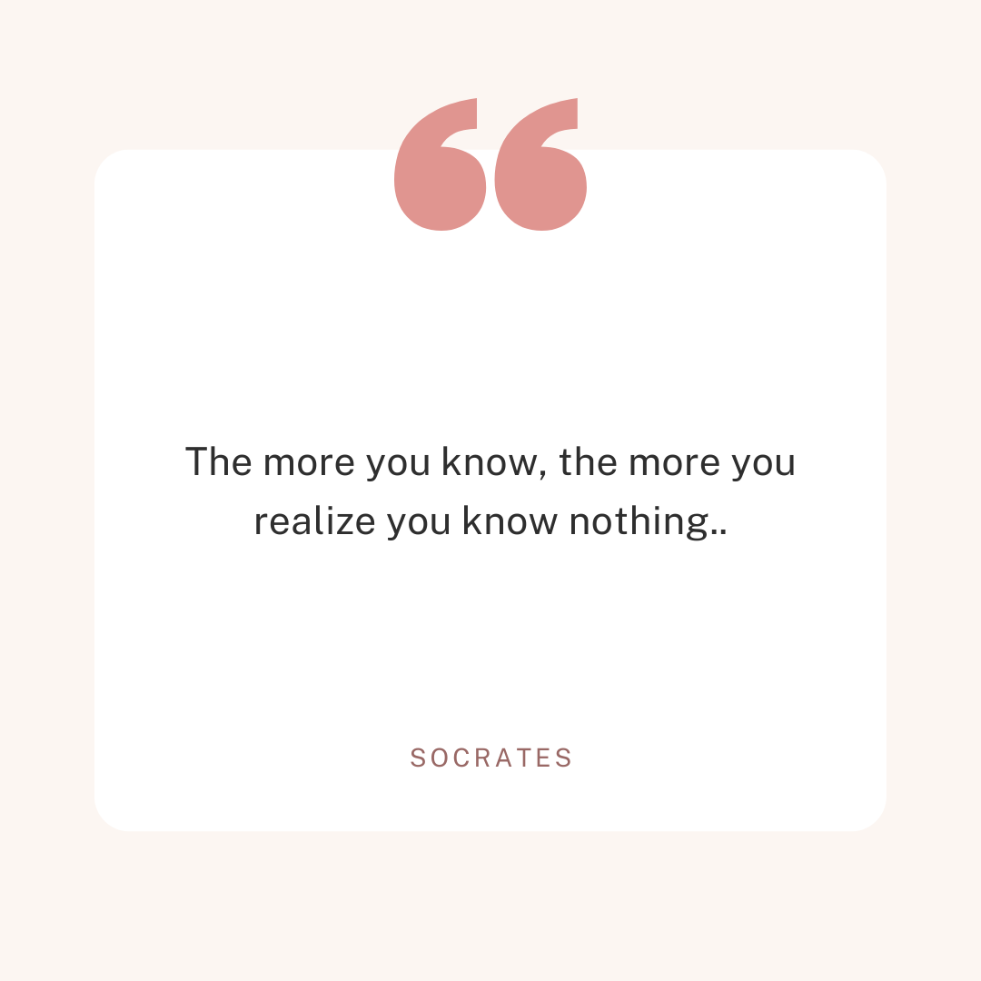
Objectives
Able to find doctors mostly when doctors are not available.
Pandemic
Late Night
Vacation
Able to find and consult with a doctor in an emergency.
To save precious life of people who die unnecessarily for not getting support in time.

Slide 6

Motivation
Pandemic
Aid not received in time.
No proper consultancy was possible because of social distancing.
Who knows this situation won’t appear again?
A stranded and aid seeking patient at late night.
First Aid information could be shared.
Time gap for getting an emergency care.

Slide 7
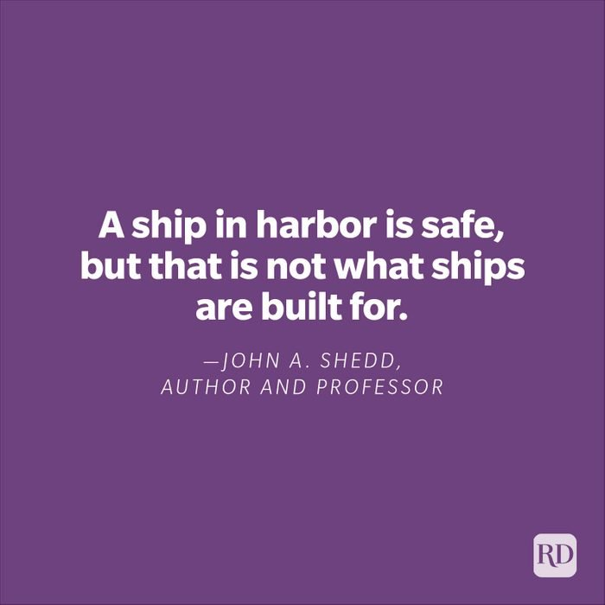
Existing Works
DocTime[1]
Search your Doctor.
Consult live on Video Call.
Instant Prescription.
Verified doctors.
Easy payment options.
Sebaghar[2]
video consultation.
Reputed doctors.
Contact within 1-2 hour.

Slide 8

Findings
None of the available system provides -
Late Night consultation.
Emergency consultation.
Emergency First Aid consultation.
Find available doctors for emergency response.

Slide 9

Features
Search available doctors for an emergency response.
Search available doctors for the late night consultation.
Search available doctors who provide free consultation.
Book home consultation.
Contact with the doctor for consultation.
Search available doctors of a region.
Take an appointment from a doctor.
View feedback and provide review to the doctors.
First aid query.

Slide 10
Features
Search available doctors for an emergency response.
Search available doctors for the late night consultation.
Search available doctors who provide free consultation.
Book home consultation.
Contact with the doctor for consultation.
Search available doctors of a region.
Take an appointment from a doctor.
View feedback and provide review to the doctors.
First aid query.

Slide 11
Unique contribution
Live chamber monitoring.
Downloadable prescription: (Can Access Any time).
Emergency helpline.
Get notification.

Slide 12
Used Technologies
Front-End Development :
Markup Language: Html 5
Design : CSS 3
Designing Framework : Bootstrap 4.0
JavaScript

Slide 13
Used Technologies
Backend Development :
PHP framework ( Laravel 8.0),
DBMS: MySQL
Software Requirement : XAMPP
Server : Apache, Mysql Server
Editor: Visual Studio

Slide 14
Design Pattern
MVC-software design pattern
Model: Mainly handle database tables attributes and relationship among tables.
View: It uses blade templating engine (User/admin interface to display data).
Controller: Handle business logic and performs all functions mechanism, Database migration (manage and handling DB).
Tinker :Command tool.
Database Seeder: Use for generate fake/dummy data.
.env file: configuration file.

Slide 15
Challenges:
Constructing the requirements of the project.
Design the database.
To implement live monitoring system.
To learn Laravel Framework , Bootstrap from beginning.
Time constraints.

Slide 16
Limitations:
This system is only web-based, not integrated with mobile application.
More features is yet to implement.
Payment gateway is not implemented yet.
Conducted fewer tested.

Slide 17
Future Work
This system is only web-based, not integrated with mobile application.
More features is yet to implement.
Live payment gateway will be implemented .
Notification system to the patient through SMS /e-mail.
Will make a proper bug free web based platform.
Add more features.

Slide 18
Demonstrations

Slide 19
Thank You

